Slide 1




Trust Bank – Lending Modernization
MKT 6364.501 S’25 – BY “AI TRESPASSERS”
Priyadarshan Parida
Sunayana Jana
Silvia Rojas Menjivar
Vaishnavi Suresh Iyer

Slide 2
Let’s Recap

Slide 3



Company Background & Problem Statement
Trust Bank has seen a 3x surge in loan applications due to the closure of a competitor bank.
Manual assessment of creditworthiness is slow and inefficient, causing potential revenue loss and customer dissatisfaction.
Seeks to explore AI-driven approach to assess creditworthiness quickly and accurately.
BACKGROUND
Small-scale community bank with limited technology infrastructure. Focused on relationship-based lending.
Traditionally, creditworthiness assessed by manual deliberation of the applicant’s financial standing.
V
VALUE: AI-driven credit assessment improves efficiency, reduces risk, and enhances customer experience.
STRENGTH
Established customer trust and local market expertise.
WEAKNESS
Manual, slow loan approval process, limited tech adoption, higher operational costs for scaling.
R
RARITY: Few community banks leverage AI in lending, creating a competitive edge.
OPPORTUNITY
Increased customer base from competitor’s closure, AI-driven
decisioning.
THREAT
Lost prospects to the competitors.
I
INIMITABLE: Machine learning models built on proprietary data can provide unique insights.
O
ORGANIZED: Requires investment in digital infrastructure, change management, and upskilling staff.

Slide 4








Lending Decisions at Trust Bank - The Current Landscape
Loan Origination
Loan Processing
Underwriting
Decisioning
Closing, Disbursement, Servicing
Approval
Customer
Bank
Loan Officer
Loan Officer / Underwriter
Sr. Underwriter
Customers apply for a loan through in-person visits, phone, or email.
The loan officer ensures the completeness of the application.
The loan officer performs a manual credit risk assessment based on the customer's financial standing.
The underwriter reviews all the documents, including the credit risk assessed in the previous step.
Disapproval
Friction points in the customer experience.
Part of the workflow that’s in scope in the current phase of engagement.
Average end-to-end lending decisions can take 1-2 weeks (excluding the closing and disbursement). The red dots highlight the areas with higher manual touchpoints that likely cause friction in customer experience.
Higher loan application volume can further exacerbate the problem. The current engagement scope only focusses on the part of the underwriting process that assesses credit risk (highlighted in dotted RED line)

Slide 5


Solution: AI - Based Credit Risk Assessment
Loan Origination
Loan Processing
Underwriting
Decisioning
Closing, Disbursement, Servicing
Approval
Customer
Bank
Loan Officer
AI System
Sr. Underwriter
Customers apply for a loan through in-person visits, phone, or email.
The loan officer ensures the completeness of the application.
Manual credit risk assessment is replaced by a Machine Learning data-driven solution.
The underwriter reviews all the documents, including the credit risk assessed in the previous step.
Disapproval
Friction points in the customer experience.
Part of the workflow that’s in scope in the current phase of engagement.
With the AI-based data-driven credit risk assessment, the average end-to-end lending decision timeline can reach 3-5 business days, i.e., down 50%.
This timely improvement can substantially alleviate the congestion caused by the surge in the inflow of loan applications.

Slide 6

Proposed Target State: Digital Lending with AI
Loan Origination
E-2-e Lending Decision
Review / Override (Optional)
Closing, Disbursement, Servicing
Approval
Customer
Front-end Application Plus AI System
Underwriter
Customers apply for a loan through the digital channels.
Underwriter reviews on sampling basis and overrides decisions as applicable.
Disapproval
The proposed target state is a digital lending application that can process loan applications end-to-end. This can provide lending decisions to the customer in real-time or near real-time.
The solution is highly scalable but does require significant upfront investment. However, the ROI is promising.

Slide 7









Technical Approach
Data Ingestion & Storage
Data Pre-processing, & EDA
Predictive Modelling
Creditworthiness Assessment
Model Deployment & Integration
Monitoring and Reinforcement
Out of scope for the current phase of engagement.
Low-code/No-code platform of choice for Predictive Modelling.
The historical data available for this implementation has data on customers’ financial standing mapped to the creditworthiness which makes this a Supervised Learning – classification problem.
Multiple classification algorithms will be compared to determine the winner. Class imbalance and overfitting problems will be carefully handled.

Slide 8
Implementation Methodology

Slide 9
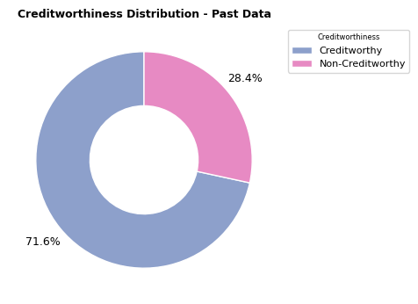
Data for Calibration & Prediction
Model Calibration
Anonymous labelled data from past creditworthiness assessments (500) used for training and testing the model.
Creditworthiness Prediction
Anonymous unlabeled data extracted from loan applications (500) used for creditworthiness prediction.
Key Features in the Data
Financial Status
Credit History
Demographics
Loan Details
Other Factors
Account-Balance Credit-Amount Value-Savings-Stocks Length-of-current-employment
Duration-of-Credit-Month Payment-Status-of-Previous-Credit No-of-Credits-at-this-Bank
Age-years Occupation No-of-dependents Type-of-apartment
Purpose Instalment-per-cent Duration-in-Current-address
Guarantors Concurrent-Credits Most-valuable-available-asset Telephone, Foreign-Worker
Data | Count of Creditworthy | Count of Non-creditworthy | Total
Past Credit Data (Labelled) | 358 | 142 | 500
Pending Applications | - | - | 500
Constraints (Impact on Model Performance)
Limited past data availability Poorly trained model, Overfitting
Class Imbalance: Model bias

Slide 10
Data Inspection & Cleaning
Categorical Features | Numerical Features
Purpose of Loan, Payment status of previous credits | Duration of credit (months), Age (in years)
1
Observe
Inspect features and distinguish as Categorical and numerical.
Data Type and Consistency Checks
Check for data types and ensure consistency based on the data definition. Make corrections or gather insights for future stages.
Data Columns | Treatment
Foreign-Worker | Categorical field stored as number. Candidate for encoding.
2
Impute missing data
Identify columns with missing data, choose right imputation technique and perform imputations.
Data Columns | Treatment
Age | Impute with median value.
3
Data Columns | Treatment
Occupation, Concurrent-Credits | Remove as columns have one value each.
Telephone | Remove as Irrelevant for Analysis
4
Remove Features Deemed Irrelevant for Analysis
Identify columns with missing data, choose right imputation technique and perform imputations.

Slide 11
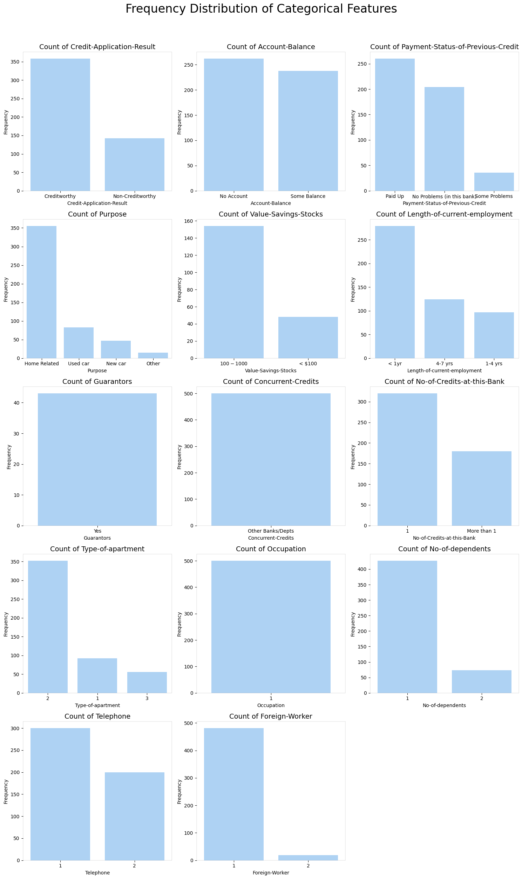
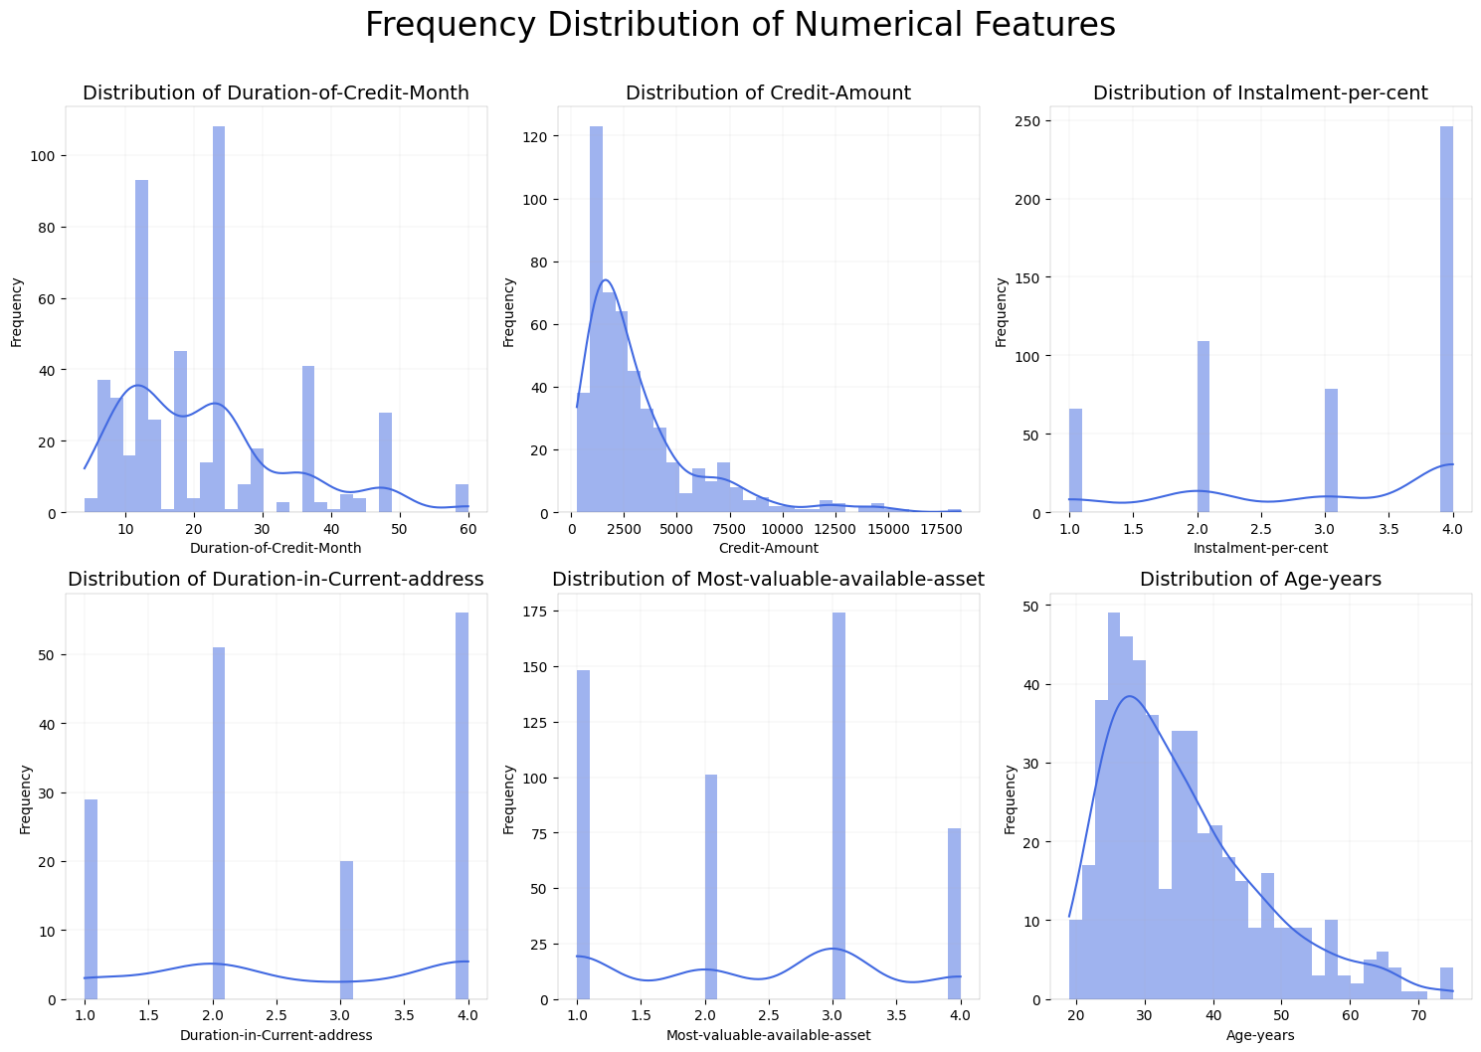
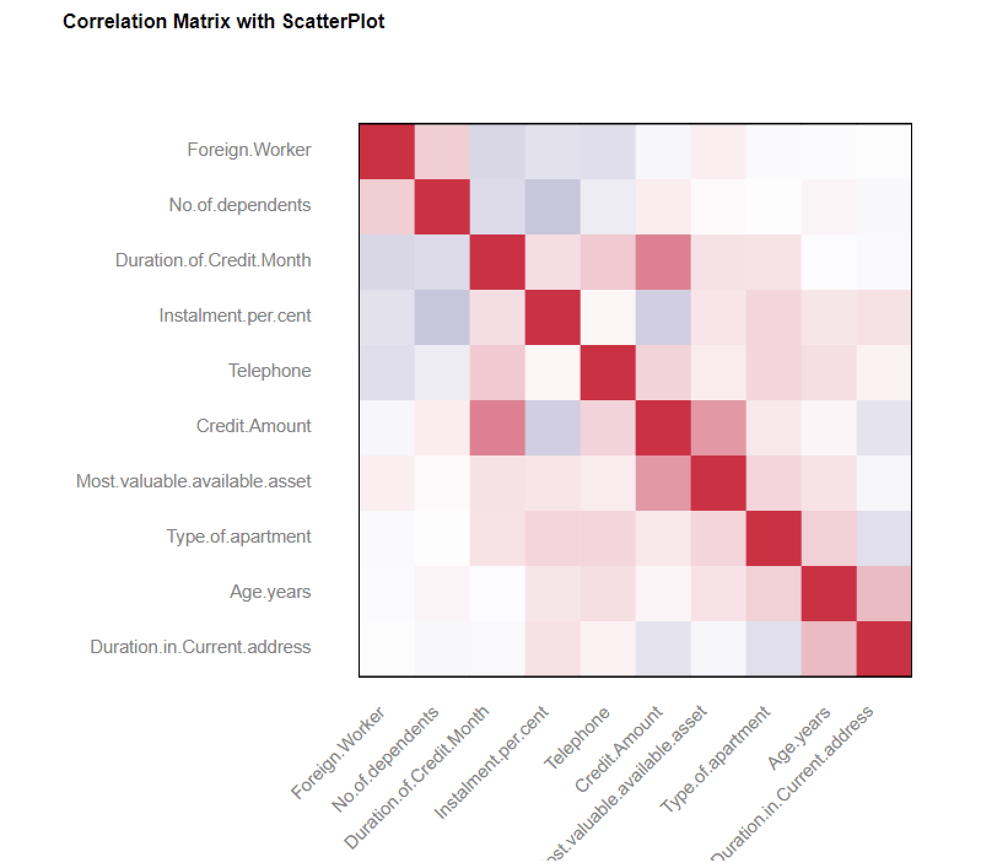
Exploratory Data Analysis
Key Insights
Home Loans dominate the landscape.
Positive correlation between the Credit Amount and the Loan Term.
Typical Applicants have limited existing relationships with the bank.
Most applicants have history of repaying credit but report low savings.
Credit amount and age are left-skewed, indicating younger borrowers take smaller loans.

Slide 12
Feature Engineering
Data Columns | Treatment
Account Balance Status e.g., No balance, some balance | One-hot encoding
1
Feature Encoding – Categorical Features (Nominal)
One-hot encode the nominal variables.
Feature Encoding – Categorical Features (Ordinal)
Label encode the ordinal variables.
Data Columns | Treatment
Length of current employment e.g., < $100, $100-$1000 | Label Encoding
2
Feature Extraction
Extract new features from current features in a way that reveals more information.
Data Columns | Treatment
Guarantors | 0 = doesn’t have guarantor 1 = has guarantor
3
4
Feature Scaling & Oversampling
Perform Standard Normal scaling to avoid feature bias.
Class Oversampling to avoid class imbalance.

Slide 13
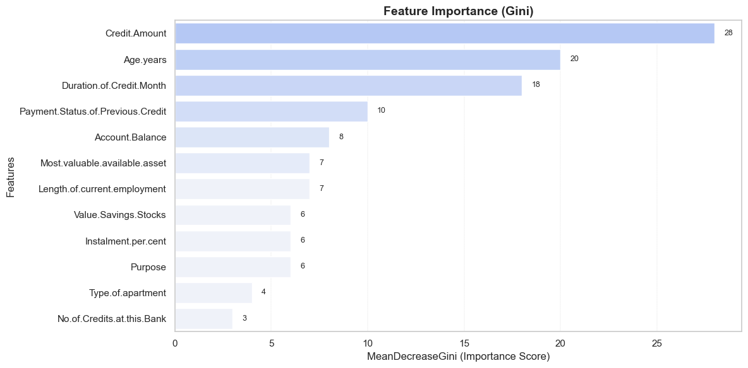
Model Evaluation & Selection
Model | Accuracy
Boosted | 74%
Decision Tree | 74%
Logistic Regression Stepwise | 77%
Random Forest | 80%
Identify nature of machine learning problem
Labeled data, creditworthiness prediction (Yes, No)
Supervised learning, classification problem
1
Determine the area of emphasis
Prediction over interpretation given lending decision depends on accurate predictability.
2
Identify algorithms that make the consideration set
Logistics Regression + Stepwise
Decision Tree
Random Forest
Boosted Model
3

Slide 14
Prediction and Reporting
Trained Random Forest Model
Class | Predicted (out of 500)
Creditworthy | 413
Non-creditworthy | 87
Score Estimator
Creditworthiness Probability
Convert into Binary
Anonymized Data from Loan Applications

Slide 15
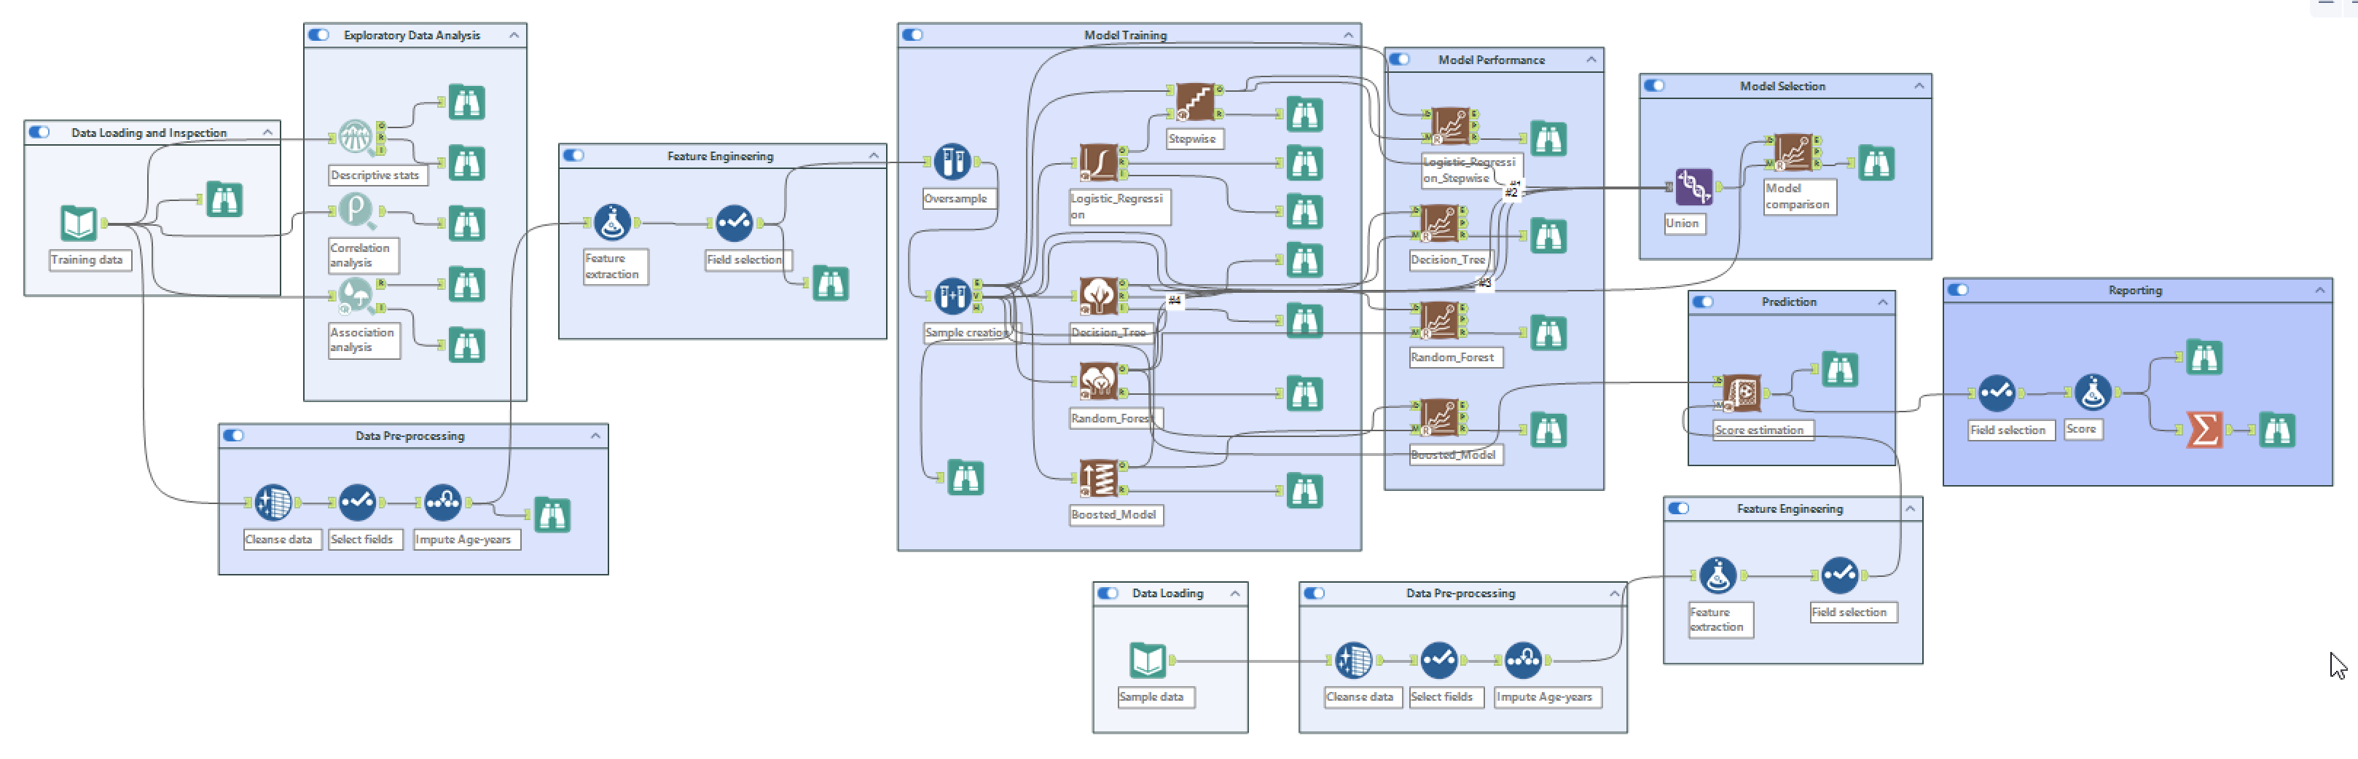
Alteryx Workflow

Slide 16
Financials & Wrap-up

Slide 17
ROI Considerations
Considerations for the expected return on investment are categorized as Financial, Operational, and Customer-centric.
Increased Origination
Improved Efficiency & Lower Cost
Increased revenue
Although the proposed target-state architecture requires a significant upfront investment, the ROI outlook is promising.
Lower Credit Losses & Loan Defaults
Customer Satisfaction & Engagement

Slide 18
Reference ROI

Slide 19
Recommendations & Next Steps - The “ELEVATE” Framework
Establish Value-Driven Transformation
Align AI adoption with business goals.
E
Leverage Tactical AI Fix PHASE 1
Implement a quick, AI-driven credit risk assessment.
L
Embrace Digitization & Digitalization
Convert analog systems to digital and use digital technologies to transform processes.
E
Vitalize Workforce with Upskilling & Change Management
AI adoption through employee training and organizational readiness.
V
Advance for Digital Lending - A Strategic Change PHASE 2
Navigate public expectations and drive adoption.
A
Transition to Cloud & SaaS-Based Lending PHASE 3
Achieve scalability and agility by leveraging cloud-based solutions.
T
Ensure Compliance, Ethical AI, and Evolve Continuously
Address regulatory requirements and prioritize responsible AI. Establish a roadmap for AI innovations.
E

Slide 20
Challenges
1
Compliance with fair lending laws (e.g., Equal Credit Opportunity Act, Fair Housing Act) and data privacy laws.
Ethical Considerations
Addressing biases, data privacy, and the responsible use of AI to ensure fair and accountable credit decision-making.
2
Risk of AI bias and discrimination leading to regulatory scrutiny.
3
Need for explainability and transparency in AI-driven decisions.
4
Ensuring fair and unbiased credit assessments across all demographics.
5
Ensuring borrowers understand how their data is used, and decisions are made in the lending process.
Regulatory Concerns
Compliance with legal and financial regulations to ensure AI-driven lending decisions are fair, transparent, and non-discriminatory.
6
Balancing automation with human oversight to maintain trust and address perceived unfairness.

Slide 21



Reflections
01
03
02
Strong Start with Limited Data
Data-first Approach
Scalability Goes Beyond Code
Achieving 80% accuracy on a small dataset demonstrates early potential, especially for a small company environment
To improve reliability and reduce bias, ongoing data collection is essential for retraining and scaling the model.
Launch a small-scale test before the full rollout. Measure sales uplift, customer response, & program adoption rates.

Slide 22
Thank you!

Slide 23
References
https://www.spglobal.com/market-intelligence/en/news-insights/research/community-bank-earnings-will-recover-despite-weaker-credit-sticky-deposit-costs
https://www.csbs.org/node/510346
https://www.dallasfed.org/research/swe/2024/swe2418
https://www.universalclass.com/articles/business/finance/loan-processing-step-by-step.htm
https://www.communitybankingconnections.org/articles/2015/q1/development-and-maintenance-of-an-effective-loan-policy
https://www.kaggle.com/datasets/thuranaing411/creditworthiness?select=customers-to-score.xlsx

Slide 24
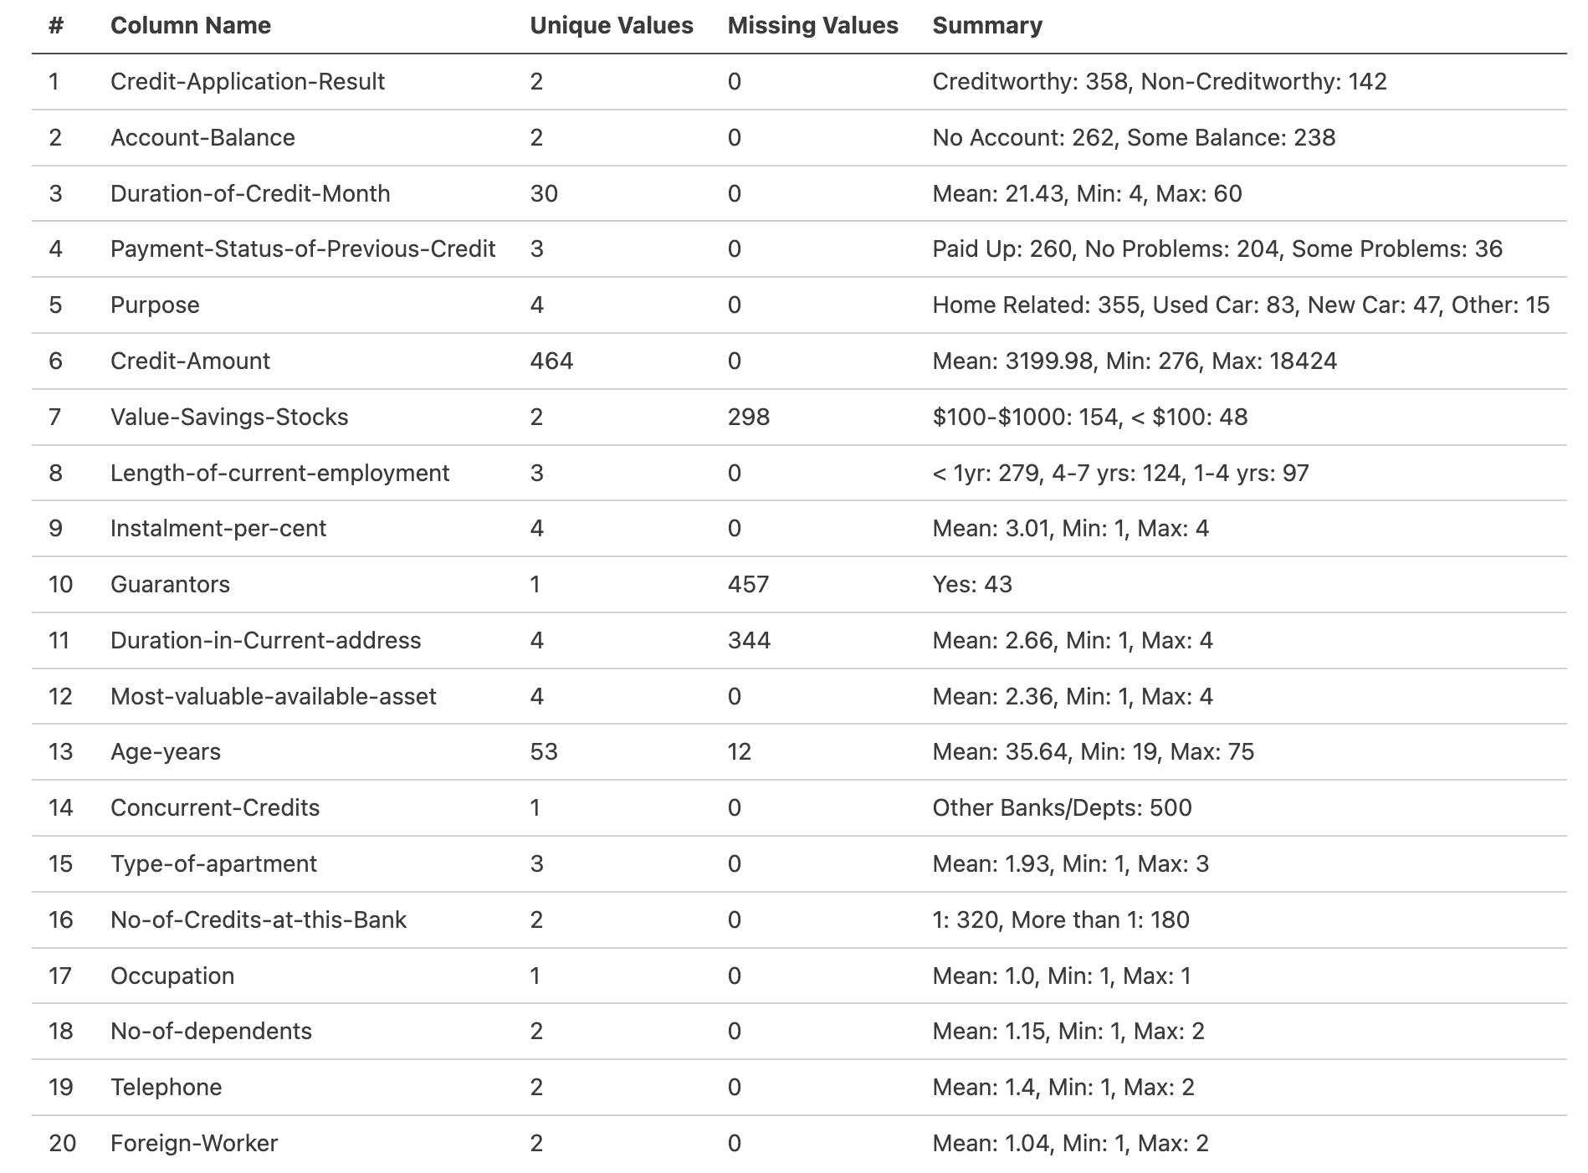
Feature Set

Slide 25
Frequency Distribution of Categorical Features
BACK

Slide 26
Frequency Distribution of Numerical Features
BACK

Slide 27
Correlation Analysis
BACK

Slide 28
Feature Importance - Gini Score
BACK

